Slide 1


Chapter 9 TRAP Routines and
Subroutines
An Hong han@ustc.edu.cn
2019 Fall
Lecture on
Introduction to Computing Systems
（01170401）
School of Computer Science and Technology

Slide 2

Great Idea from Ancient Chinese Philosophy
All things come into being, all things come into nothing
_{天下万物生于有, 有生于无}
《老子·四十章》
《易经》
      _{太极生两仪，}
      _{两仪生四象，}
      _{四象生八卦，}
      _{八卦演万物。}

Slide 3
Levels of Abstraction
Application
Solve a system of equations
Algorithm and Data Structure
Gaussian
elimination
Jacobi
iteration
Programming Language/Compiler
Red-black SOR
Multigrid
Operating System/Virtual Machines
FORTRAN
C
C++
Java
Instruction Set Architecture (ISA)
Microarchitecture
Sun SPARC
Intel x86
IBM PowerPC
Gates/Register-Transfer Level (RTL)
Pentium 4
Core 2 Duo
AMD Athlon X2
Analog/Digital Circuits
Electronic Devices
Ripple-carry adder
Carry-lookahead adder
Physics
Static CMOS
Dynamic CMOS
Nanomechanical

Slide 4
Great Ideas in Computer Architecture in ICS
Great Idea #1: Computer is an Universal Computing Device(Turing Machine Model)
Great Idea #2: Stored program computer(Von Neumann Model)
Great Idea #3: Abstraction Helps Us Manage Complexity(Layers of Representation/Interpretation)
Great Idea #4: Software and Hardware Co-design

Slide 5
Computational model (Turing machine) vs. Structural model (Von structure)
Tadd, Tmul
U
a,b,c
c(a+b)
Universal Turing Machine

Slide 6
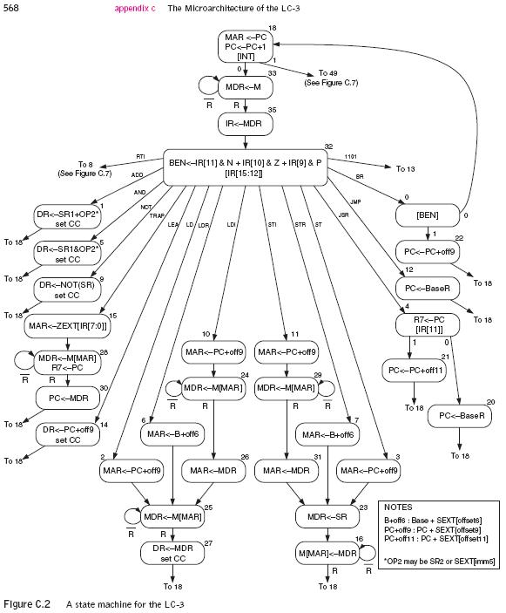
Computational model (Turing machine) vs. Structural model (Von structure)
Tadd, Tmul
U
a,b,c
c(a+b)
Universal Turing Machine

Slide 7
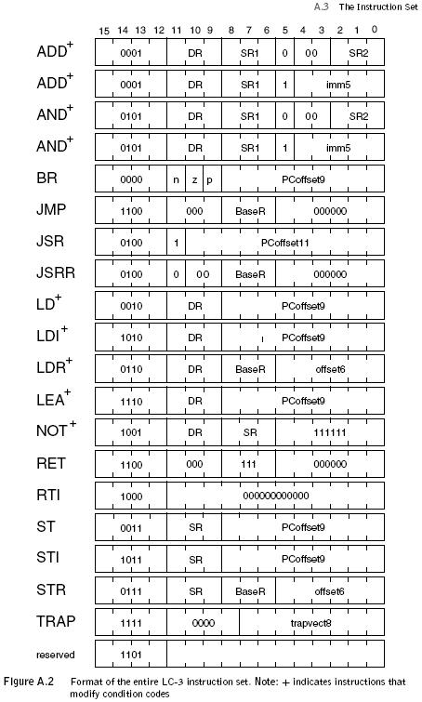
Instruction Set Architecture (ISA) vs. Finite State Automata

Slide 8
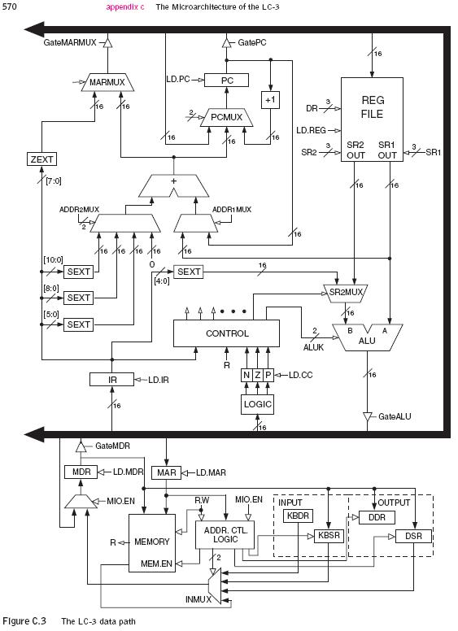
Computer microarchitecture vs. Finite State Automata

Slide 9
Levels of Abstraction
Application
Solve a system of equations
Algorithm and Data Structure
Gaussian
elimination
Jacobi
iteration
Programming Language/Compiler
Red-black SOR
Multigrid
Operating System/Virtual Machines
FORTRAN
C
C++
Java
Instruction Set Architecture (ISA)
Microarchitecture
Sun SPARC
Intel x86
IBM PowerPC
Gates/Register-Transfer Level (RTL)
Pentium 4
Core 2 Duo
AMD Athlon X2
Analog/Digital Circuits
Electronic Devices
Ripple-carry adder
Carry-lookahead adder
Physics
Static CMOS
Dynamic CMOS
Nanomechanical

Slide 10


N-type MOS Transistor
Gate = 1
Gate = 0
Terminal #2 must be
connected to GND (0V).
MOS = Metal Oxide Semiconductor
  two types: N-type and P-type
N-type
  when Gate has positive voltage,
  short circuit between #1 and #2
  (switch closed)
  when Gate has zero voltage,
  open circuit between #1 and #2
  (switch open)
Notes:
10

Slide 11
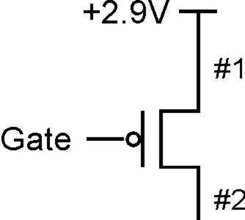
P-type MOS Transistor
Gate = 1
Gate = 0
Terminal #1 must be
connected to +2.9V.
P-type is complementary to N-type
  when Gate has positive voltage,
  open circuit between #1 and #2
  (switch open)
  when Gate has zero voltage,
  short circuit between #1 and #2
  (switch closed)
Notes:
11

Slide 12
Levels of Abstraction
Application
Solve a system of equations
Algorithm and Data Structure
Gaussian
elimination
Jacobi
iteration
Programming Language/Compiler
Red-black SOR
Multigrid
Operating System/Virtual Machines
FORTRAN
C
C++
Java
Instruction Set Architecture (ISA)
Microarchitecture
Sun SPARC
Intel x86
IBM PowerPC
Gates/Register-Transfer Level (RTL)
Pentium 4
Core 2 Duo
AMD Athlon X2
Analog/Digital Circuits
Electronic Devices
Ripple-carry adder
Carry-lookahead adder
Physics
Static CMOS
Dynamic CMOS
Nanomechanical

Slide 13
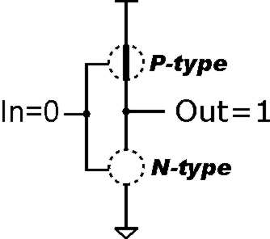
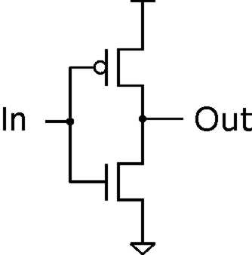
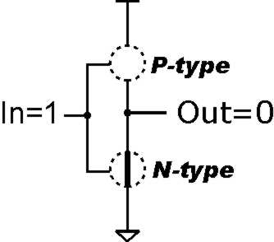
Inverter (NOT Gate)
2.9V
Truth table
0V
In | Out
0 V | 2.9 V
2.9 V | 0 V
In | Out
0 | 1
1 | 0
Notes:
13

Slide 14
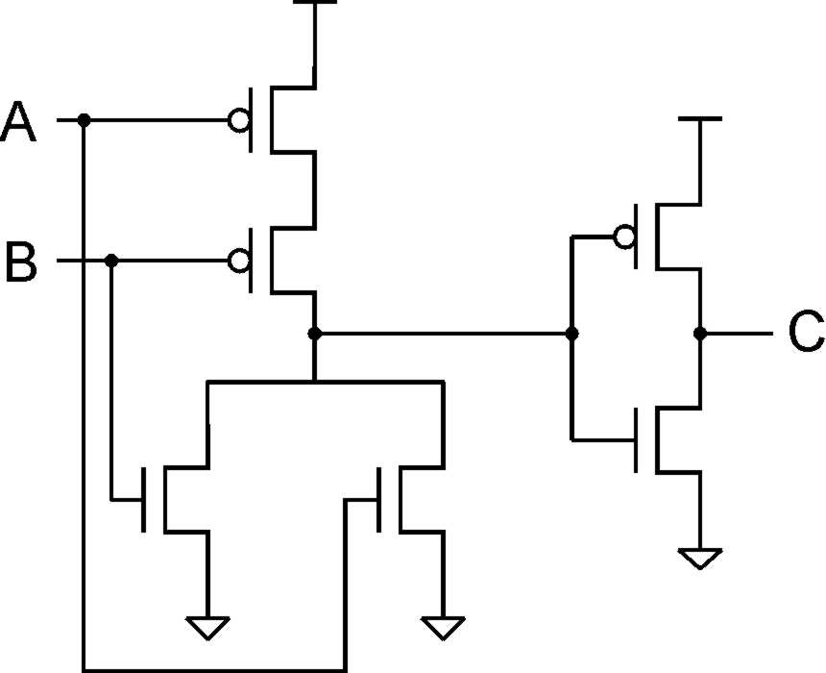
OR Gate
A | B | C
0 | 0 | 0
0 | 1 | 1
1 | 0 | 1
1 | 1 | 1
Add inverter to NOR.

Slide 15
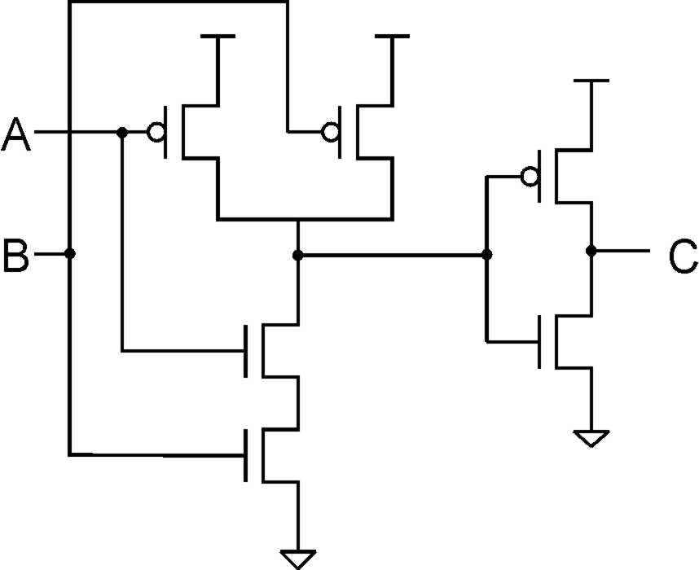
AND Gate
A | B | C
0 | 0 | 0
0 | 1 | 0
1 | 0 | 0
1 | 1 | 1
Add inverter to NAND.

Slide 16
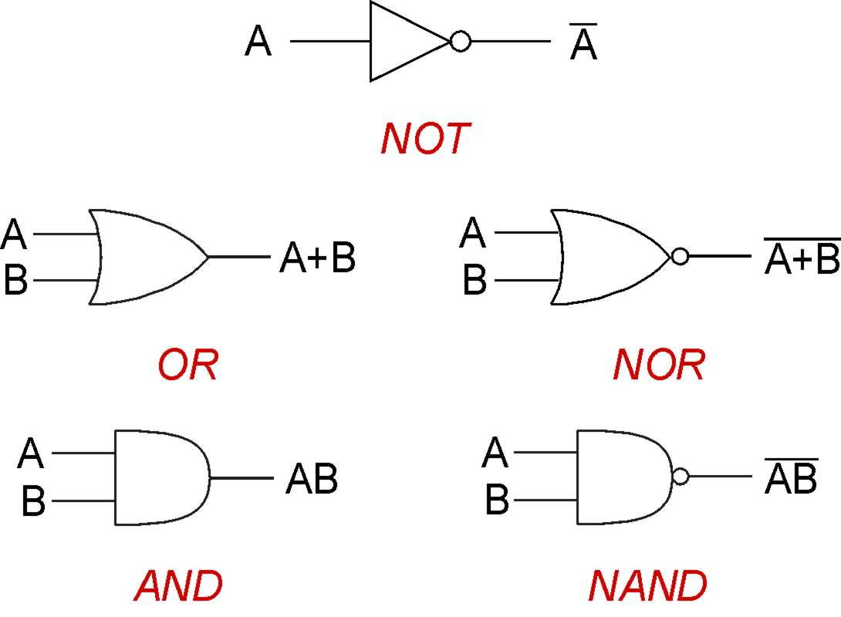
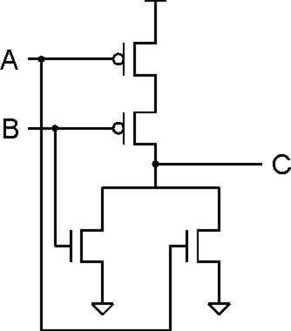
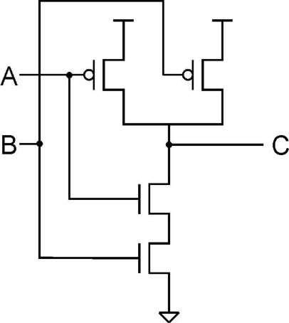
晶体管，门

Slide 17
Levels of Abstraction
Application
Solve a system of equations
Algorithm and Data Structure
Gaussian
elimination
Jacobi
iteration
Programming Language/Compiler
Red-black SOR
Multigrid
Operating System/Virtual Machines
FORTRAN
C
C++
Java
Instruction Set Architecture (ISA)
Microarchitecture
Sun SPARC
Intel x86
IBM PowerPC
Gates/Register-Transfer Level (RTL)
Pentium 4
Core 2 Duo
AMD Athlon X2
Analog/Digital Circuits
Electronic Devices
Ripple-carry adder
Carry-lookahead adder
Physics
Static CMOS
Dynamic CMOS
Nanomechanical

Slide 18
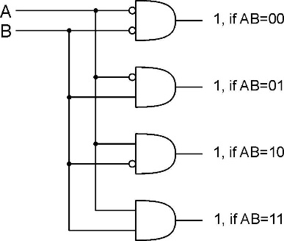
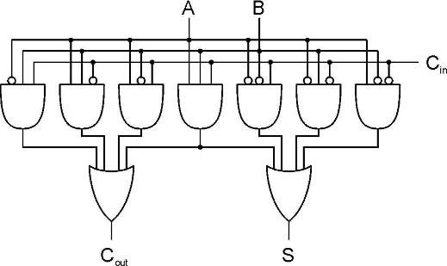
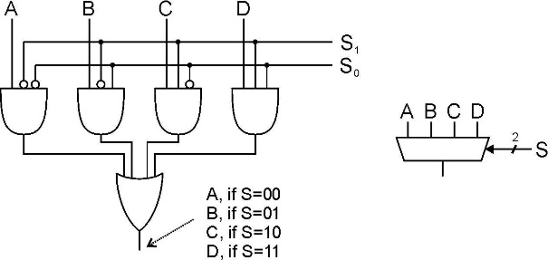
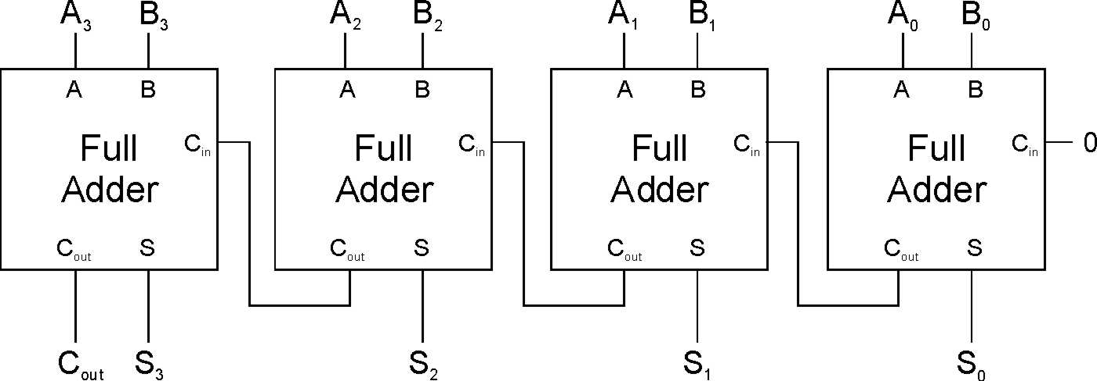
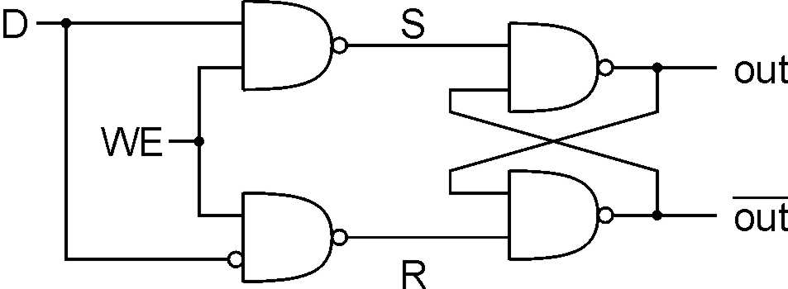
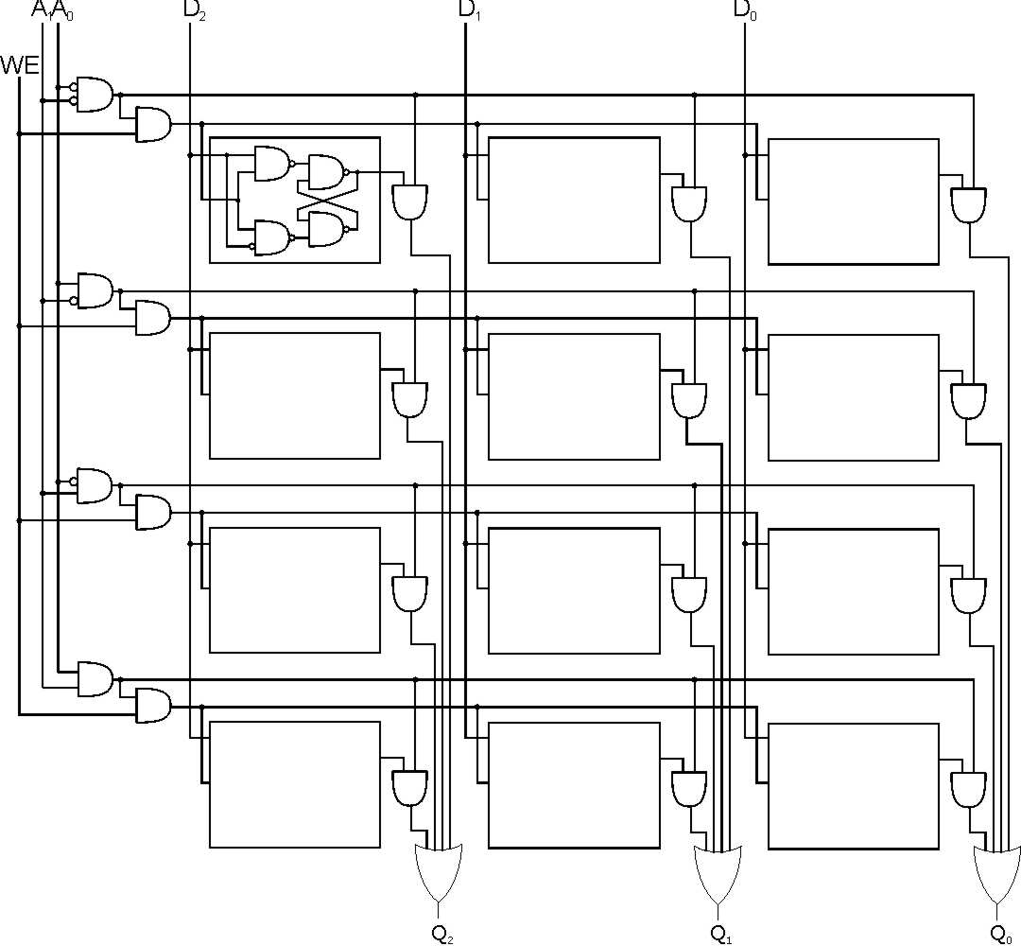
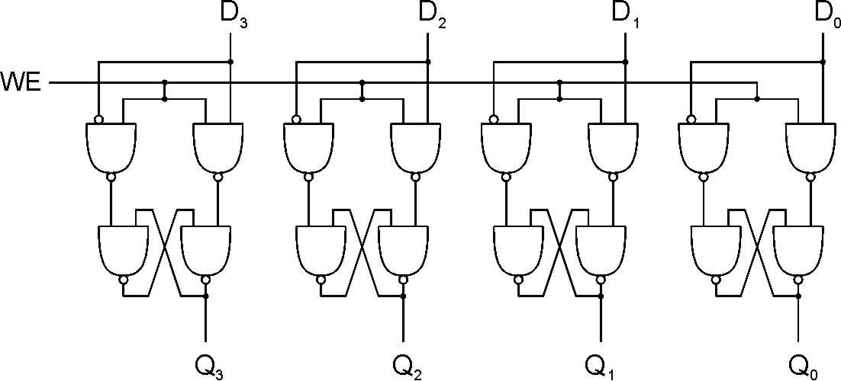
Basic Logical Structure

Slide 19
Levels of Abstraction
Application
Solve a system of equations
Algorithm and Data Structure
Gaussian
elimination
Jacobi
iteration
Programming Language/Compiler
Red-black SOR
Multigrid
Operating System/Virtual Machines
FORTRAN
C
C++
Java
Instruction Set Architecture (ISA)
Microarchitecture
Sun SPARC
Intel x86
IBM PowerPC
Gates/Register-Transfer Level (RTL)
Pentium 4
Core 2 Duo
AMD Athlon X2
Analog/Digital Circuits
Electronic Devices
Ripple-carry adder
Carry-lookahead adder
Physics
Static CMOS
Dynamic CMOS
Nanomechanical

Slide 20
LC-3 Data Path(Microarchitecture)
₁₆
GatePC
₁₆
GateMARMUX
LD.PC
PC
DR
₃
MARMUX
+1
REG FILE
₁₆
₂
PCMUX
₁₆
₁₆
₁₆
₁₆
₁₆
LD.REG
Control Unit
SR2
OUT
SR1
OUT
[7:0]
Processing Unit
SEXT
₊
SR2
₃
₃
SR1
ADDR2MUX
MUX
MUX
ADDR1MUX
₁₆
₁₆
[10:0]
₁₆
₁₆
₁₆
₁₆
₁₆
SEXT
[8:0]
LD.CC
₁₆
SEXT
FINITE STATE MACHINE
SR2MUX
[5:0]
SEXT
₁₆
N
Z
P
ALUK
_{A}
_{B}
[4:0]
SEXT
₂
ALU
LD.IR
IR
LOGIC
…
₁₆
₁₆
₁₆
RUN
GateALU
₁₆
GateMDR
₁₆
Memory Unit
LD.MDR
MDR
MEMORY
MAR
LD.MAR
₁₆
INPUT
OUTPUT
MIO.EN
MUX
₁₆
MEM.EN,R,W

Slide 21
Levels of Abstraction
Application
Solve a system of equations
Algorithm and Data Structure
Gaussian
elimination
Jacobi
iteration
Programming Language/Compiler
Red-black SOR
Multigrid
Operating System/Virtual Machines
FORTRAN
C
C++
Java
Instruction Set Architecture (ISA)
Microarchitecture
Sun SPARC
Intel x86
IBM PowerPC
Gates/Register-Transfer Level (RTL)
Pentium 4
Core 2 Duo
AMD Athlon X2
Analog/Digital Circuits
Electronic Devices
Ripple-carry adder
Carry-lookahead adder
Physics
Static CMOS
Dynamic CMOS
Nanomechanical

Slide 22
LC-3 ISA Overview
_{运算指令(Operate Instructions)}
₁₅
₁₄
₁₃
₁₂
₁₁
₁₀
₉
₈
₇
₆
₅
₄
₃
₂
₁
₀
_{数据移动指令}
_{(Data Movement Instructions)}
_{ADD}
₀
₀
₀
₁
_{DR}
_{SR1}
₀
₀
₀
_{SR2}
_{ADD}
₀
₀
₀
₁
_{DR}
_{SR1}
₁
_{Imm5}
_{取数指令(Load)}
_{AND}
₀
₁
₀
₁
_{DR}
_{SR1}
₀
₀
₀
_{SR2}
_{AND}
₀
₁
₀
₁
_{DR}
_{SR1}
₁
_{Imm5}
₁₅
₁₄
₁₃
₁₂
₁₁
₁₀
₉
₈
₇
₆
₅
₄
₃
₂
₁
₀
_{LD}
₀
₀
₁
₀
_{DR}
_{PCoffset9}
_{NOT}
₁
₀
₀
₁
_{DR}
_{SR1}
₁
₁
₁
₁
₁
₁
_{LDR}
₀
₁
₁
₀
_{DR}
_{BaseR}
_{PCoffset6}
_{Reserved}
₁
₁
₀
₁
_{LDI}
₁
₀
₁
₀
_{DR}
_{PCoffset9}
_{控制指令(Control Instructions)}
_{LEA}
₁
₁
₁
₀
_{DR}
_{PCoffset9}
₁₅
₁₄
₁₃
₁₂
₁₁
₁₀
₉
₈
₇
₆
₅
₄
₃
₂
₁
₀
_{存数指令(Store)}
_{BR}
₀
₀
₀
₀
_{n}
_{z}
_{p}
_{PCoffset9}
_{JSR}
₀
₁
₀
₀
₁
_{PCoffset11}
₁₅
₁₄
₁₃
₁₂
₁₁
₁₀
₉
₈
₇
₆
₅
₄
₃
₂
₁
₀
_{JSRR}
₀
₁
₀
₀
₀
₀
₀
_{BaseR}
₀
₀
₀
₀
₀
₀
_{ST}
₀
₀
₁
₁
_{SR}
_{PCoffset9}
_{RTI}
₁
₀
₀
₀
₀
₀
₀
₀
₀
₀
₀
₀
₀
₀
₀
₀
_{STR}
₀
₁
₁
₁
_{SR}
_{BaseR}
_{PCoffset6}
_{JMP}
₁
₁
₀
₀
₀
₀
₀
_{BaseR}
₀
₀
₀
₀
₀
₀
_{STI}
₁
₀
₁
₁
_{SR}
_{PCoffset9}
_{RET}
₁
₁
₀
₀
₀
₀
₀
₁
₁
₁
₀
₀
₀
₀
₀
₀
_{TRAP}
₁
₁
₁
₁
₀
₀
₀
₀
_{TrapVector8}

Slide 23
Levels of Abstraction
Application
Solve a system of equations
Algorithm and Data Structure
Gaussian
elimination
Jacobi
iteration
Programming Language/Compiler
Red-black SOR
Multigrid
Operating System/Virtual Machines
FORTRAN
C
C++
Java
Instruction Set Architecture (ISA)
Microarchitecture
Sun SPARC
Intel x86
IBM PowerPC
Gates/Register-Transfer Level (RTL)
Pentium 4
Core 2 Duo
AMD Athlon X2
Analog/Digital Circuits
Electronic Devices
Ripple-carry adder
Carry-lookahead adder
Physics
Static CMOS
Dynamic CMOS
Nanomechanical

Slide 24
Today: CONTROL in Von Neumann Model

Slide 25
Today: Control Instructions
15
14
13
12
11
10
9
8
7
6
5
4
3
2
1
0
BR
0
0
0
0
n
z
p
PCoffset9
JSR
0
1
0
0
1
PCoffset11
JSRR
0
1
0
0
0
0
0
BaseR
0
0
0
0
0
0
RTI
1
0
0
0
0
0
0
0
0
0
0
0
0
0
0
0
JMP
1
1
0
0
0
0
0
BaseR
0
0
0
0
0
0
RET
1
1
0
0
0
0
0
1
1
1
0
0
0
0
0
0
TRAP
1
1
1
1
0
0
0
0
TrapVector8

Slide 26
Today: CONTROL in LC-3 Data Path
16
GatePC
16
GateMARMUX
LD.PC
PC
DR
3
MARMUX
+1
REG FILE
16
2
PCMUX
16
16
16
16
16
LD.REG
Control Unit
SR2
OUT
SR1
OUT
[7:0]
SEXT
SR2
3
SR1
+
3
ADDR2MUX
MUX
MUX
ADDR1MUX
16
16
[10:0]
16
16
16
16
16
SEXT
[8:0]
LD.CC
16
SEXT
FINITE STATE MACHINE
SR2MUX
[5:0]
SEXT
16
N
Z
P
ALUK
A
B
[4:0]
SEXT
2
ALU
LD.IR
IR
LOGIC
…
16
16
16
RUN
GateALU
16
GateMDR
16
LD.MDR
MDR
MEMORY
MAR
LD.MAR
16
INPUT
OUTPUT
MIO.EN
MUX
16
MEM.EN,R,W

Slide 27
System Calls
Some ops. require specialized knowledge and protection
  Abstract I/O device registers and how to use them, Programmers don’t want to know this!
  Protection for shared I/O resources - isolate programs from OS
  Reuse of common code
Solution: service routines or system calls
  Low-level, privileged operations performed by operating system
1. User program invokes system call
2. Operating system code:
  Saves registers
  Performs operation
  Restores registers
3. Returns control to user program

Slide 28
LC-3 TRAP Mechanism
Provides set of service routines
  Part of operating system -- routines start at arbitrary addresses
  Up to 256 routines
Requires table of starting addresses
  Stored in memory (x0000 through x00FF)
  Used to associate code with trap number
  Called System Control Block (or Trap Vector Table)
Uses TRAP instruction
  Used by program to transfer control to operating system (w/ privileges)
  8-bit trap vector names one of the 256 service routines
Uses “RET” instruction(JMP R7)
  Returns control to the user program (w/o privileges)
  Execution resumes immediately after the TRAP instruction

Slide 29
LC-3 TRAP Routines(service routines)
  GETC (TRAP x20)
    Read a single character from KBD.
    ASCII copied in R0, R0[15:8] cleared.
  OUT (TRAP x21)
    Write R0[7:0] to CRT.
  PUTS (TRAP x22)
    Write a string to CRT. String address in R0.
  IN (TRAP x23)
    Print a prompt on the screen and read a single character from KBD.
    Character is echoed to Display. ASCII copied to R0[7:0] and R0[15:8] cleared.
  HALT (TRAP x25)
    Prints message on CRT & halts execution.
x0000
预留代码空间
(实用代码空间)
:
:
:
x0020
x0400
48
x0021
x0430
32(14)
x0022
x0450
96
x0023
x04A0
64(42)
x0024
x04E0
x0025
xFD70
:
:
:
x00FF
The LC-3 System
Control Block

Slide 30
Today: Control Instructions
15
14
13
12
11
10
9
8
7
6
5
4
3
2
1
0
BR
0
0
0
0
n
z
p
PCoffset9
JSR
0
1
0
0
1
PCoffset11
JSRR
0
1
0
0
0
0
0
BaseR
0
0
0
0
0
0
RTI
1
0
0
0
0
0
0
0
0
0
0
0
0
0
0
0
JMP
1
1
0
0
0
0
0
BaseR
0
0
0
0
0
0
RET
1
1
0
0
0
0
0
1
1
1
0
0
0
0
0
0
TRAP
1
1
1
1
0
0
0
0
TrapVector8

Slide 31
TRAP Instruction
15 14 13 12
11 10 9 8
7 6 5 4 3 2 1 0
TRAP
1 1 1 1
0 0 0 0
trapvector8
Trap vector
  Identifies which system call to invoke
  Serves as index into table of service routine addresses
    LC-3: table stored in memory at 0x0000 – 0x00FF
    8-bit trap vector zero-extended to form 16-bit address
  Enters privileged mode
Where to go
  Lookup starting address from table; place in PC
Enabling return
  Save address of next instruction after TRAP (current PC) in R7
  R7 ← PC

Slide 32
TRAP Mechanism Operation
①
②
RET(JMP R7)
③

Slide 33
F
D
EA
TRAP
OP
16
GatePC
16
GateMARMUX
EX
LD.PC
PC
DR
3
MARMUX
+1
REG FILE
16
2
PCMUX
16
16
16
16
16
LD.REG
S
[7:0]
SR2
SR2
OUT
SR1
OUT
SR1
SEXT
+
3
3
ADDR2MUX
MUX
MUX
ADDR1MUX
16
16
[10:0]
16
16
16
16
16
SEXT
[8:0]
LD.CC
16
SEXT
FINITE STATE MACHINE
SR2MUX
[5:0]
SEXT
16
N
Z
P
ALUK
A
B
[4:0]
SEXT
2
ALU
LD.IR
IR
LOGIC
…
16
16
16
RUN
GateALU
16
GateMDR
16
LD.MDR
MDR
MEMORY
MAR
LD.MAR
16
INPUT
OUTPUT
MIO.EN
MUX
16
MEM.EN,R,W

Slide 34
F
D
EA
TRAP
OP
16
GatePC
16
GateMARMUX
EX
LD.PC
PC
DR
3
MARMUX
+1
REG FILE
16
2
PCMUX
16
16
16
16
16
LD.REG
S
[7:0]
SR2
SR2
OUT
SR1
OUT
SR1
SEXT
+
3
3
ADDR2MUX
MUX
MUX
ADDR1MUX
16
16
[10:0]
16
16
16
16
16
SEXT
[8:0]
LD.CC
16
SEXT
FINITE STATE MACHINE
SR2MUX
[5:0]
SEXT
16
N
Z
P
ALUK
A
B
[4:0]
SEXT
2
ALU
LD.IR
IR
LOGIC
…
16
16
16
RUN
GateALU
16
GateMDR
16
LD.MDR
MDR
MEMORY
MAR
LD.MAR
16
INPUT
OUTPUT
MIO.EN
MUX
16
MEM.EN,R,W

Slide 35
F
D
EA
TRAP
OP
16
GatePC
16
GateMARMUX
EX
LD.PC
PC
DR
3
MARMUX
+1
REG FILE
16
2
PCMUX
16
16
16
16
16
LD.REG
S
[7:0]
SR2
SR2
OUT
SR1
OUT
SR1
SEXT
+
3
3
ADDR2MUX
MUX
MUX
ADDR1MUX
16
16
[10:0]
16
16
16
16
16
SEXT
[8:0]
LD.CC
16
SEXT
FINITE STATE MACHINE
SR2MUX
[5:0]
SEXT
16
N
Z
P
ALUK
A
B
[4:0]
SEXT
2
ALU
LD.IR
IR
LOGIC
…
16
16
16
RUN
GateALU
16
GateMDR
16
LD.MDR
MDR
MEMORY
MAR
LD.MAR
16
INPUT
OUTPUT
MIO.EN
MUX
16
MEM.EN,R,W

Slide 36
TRAP
F
D
EA
OP
EX
S
16
GatePC
16
GateMARMUX
LD.PC
PC
DR
3
MARMUX
+1
REG FILE
16
2
PCMUX
16
16
16
16
16
LD.REG
[7:0]
SR2
SR2
OUT
SR1
OUT
SR1
SEXT
+
3
3
ADDR2MUX
MUX
MUX
ADDR1MUX
16
16
[10:0]
16
16
16
16
16
SEXT
[8:0]
LD.CC
16
SEXT
FINITE STATE MACHINE
SR2MUX
[5:0]
SEXT
16
N
Z
P
ALUK
A
B
[4:0]
SEXT
2
ALU
LD.IR
IR
LOGIC
…
16
16
16
RUN
GateALU
16
GateMDR
16
LD.MDR
MDR
MEMORY
MAR
LD.MAR
16
INPUT
OUTPUT
MIO.EN
MUX
16
MEM.EN,R,W

Slide 37
TRAP
F
D
EA
OP
EX
S
16
GatePC
16
GateMARMUX
LD.PC
PC
DR
3
MARMUX
+1
REG FILE
16
2
PCMUX
16
16
16
16
16
LD.REG
[7:0]
SR2
SR2
OUT
SR1
OUT
SR1
SEXT
+
3
3
ADDR2MUX
MUX
MUX
ADDR1MUX
16
16
[10:0]
16
16
16
16
16
SEXT
[8:0]
LD.CC
16
SEXT
FINITE STATE MACHINE
SR2MUX
[5:0]
SEXT
16
N
Z
P
ALUK
A
B
[4:0]
SEXT
2
ALU
LD.IR
IR
LOGIC
…
16
16
16
RUN
GateALU
16
GateMDR
16
LD.MDR
MDR
MEMORY
MAR
LD.MAR
16
INPUT
OUTPUT
MIO.EN
MUX
16
MEM.EN,R,W

Slide 38
TRAP
F
D
EA
OP
EX
S
16
GatePC
16
GateMARMUX
LD.PC
PC
DR
3
MARMUX
+1
REG FILE
16
2
PCMUX
16
16
16
16
16
LD.REG
[7:0]
SR2
SR2
OUT
SR1
OUT
SR1
SEXT
+
3
3
ADDR2MUX
MUX
MUX
ADDR1MUX
16
16
[10:0]
16
16
16
16
16
SEXT
[8:0]
LD.CC
16
SEXT
FINITE STATE MACHINE
SR2MUX
[5:0]
SEXT
16
N
Z
P
ALUK
A
B
[4:0]
SEXT
2
ALU
LD.IR
IR
LOGIC
…
16
16
16
RUN
GateALU
16
GateMDR
16
LD.MDR
MDR
MEMORY
MAR
LD.MAR
16
INPUT
OUTPUT
MIO.EN
MUX
16
MEM.EN,R,W

Slide 39
RET instruction
RET – return instruction
  How to return
    Place address in R7 in PC, Return the execution to the last calling point.
  PC ← (R7)
15 14 13 12
11 10 9 8 7 6
5 4 3 2 1 0
RET
(JMP R7)
1 1 0 0
0 0 0
1 1 1
0 0 0 0 0 0

Slide 40
F
D
EA
JMP R7(Register)
OP
16
GatePC
16
GateMARMUX
EX
LD.PC
PC
DR
3
MARMUX
+1
REG FILE
16
2
PCMUX
16
16
16
16
16
LD.REG
S
[7:0]
SR2
SR2
OUT
SR1
OUT
SR1
SEXT
+
3
3
ADDR2MUX
MUX
MUX
ADDR1MUX
16
16
[10:0]
16
16
16
16
16
SEXT
[8:0]
LD.CC
16
SEXT
FINITE STATE MACHINE
SR2MUX
[5:0]
SEXT
16
N
Z
P
ALUK
A
B
[4:0]
SEXT
2
ALU
LD.IR
IR
LOGIC
…
16
16
16
RUN
GateALU
16
GateMDR
16
LD.MDR
MDR
MEMORY
MAR
LD.MAR
16
INPUT
OUTPUT
MIO.EN
MUX
16
MEM.EN,R,W

Slide 41
F
D
EA
JMP R7(Register)
OP
16
GatePC
16
GateMARMUX
EX
LD.PC
PC
DR
3
MARMUX
+1
REG FILE
16
2
PCMUX
16
16
16
16
16
LD.REG
S
[7:0]
SR2
SR2
OUT
SR1
OUT
SR1
SEXT
+
3
3
ADDR2MUX
MUX
MUX
ADDR1MUX
16
16
[10:0]
16
16
16
16
16
SEXT
[8:0]
LD.CC
16
SEXT
FINITE STATE MACHINE
SR2MUX
[5:0]
SEXT
16
N
Z
P
ALUK
A
B
[4:0]
SEXT
2
ALU
LD.IR
IR
LOGIC
…
16
16
16
RUN
GateALU
16
GateMDR
16
LD.MDR
MDR
MEMORY
MAR
LD.MAR
16
INPUT
OUTPUT
MIO.EN
MUX
16
MEM.EN,R,W

Slide 42
F
D
EA
JMP R7(Register)
OP
16
GatePC
16
GateMARMUX
EX
LD.PC
PC
DR
3
MARMUX
+1
REG FILE
16
2
PCMUX
16
16
16
16
16
LD.REG
S
[7:0]
SR2
SR2
OUT
SR1
OUT
SR1
SEXT
+
3
3
ADDR2MUX
MUX
MUX
ADDR1MUX
16
16
[10:0]
16
16
16
16
16
SEXT
[8:0]
LD.CC
16
SEXT
FINITE STATE MACHINE
SR2MUX
[5:0]
SEXT
16
N
Z
P
ALUK
A
B
[4:0]
SEXT
2
ALU
LD.IR
IR
LOGIC
…
16
16
16
RUN
GateALU
16
GateMDR
16
LD.MDR
MDR
MEMORY
MAR
LD.MAR
16
INPUT
OUTPUT
MIO.EN
MUX
16
MEM.EN,R,W

Slide 43
JMP R7(Register)
F
D
EA
OP
EX
S
16
GatePC
16
GateMARMUX
LD.PC
PC
DR
3
MARMUX
+1
REG FILE
16
2
PCMUX
16
16
16
16
16
LD.REG
[7:0]
SR2
SR2
OUT
SR1
OUT
SR1
SEXT
+
3
3
ADDR2MUX
MUX
MUX
ADDR1MUX
16
16
[10:0]
16
16
16
16
16
SEXT
[8:0]
LD.CC
16
SEXT
FINITE STATE MACHINE
SR2MUX
[5:0]
SEXT
16
N
Z
P
ALUK
A
B
[4:0]
SEXT
2
ALU
LD.IR
IR
LOGIC
…
16
16
16
RUN
GateALU
16
GateMDR
16
LD.MDR
MDR
MEMORY
MAR
LD.MAR
16
INPUT
OUTPUT
MIO.EN
MUX
16
MEM.EN,R,W

Slide 44
JMP R7(Register)
F
D
EA
OP
EX
S
16
GatePC
16
GateMARMUX
LD.PC
PC
DR
3
MARMUX
+1
REG FILE
16
2
PCMUX
16
16
16
16
16
LD.REG
[7:0]
SR2
SR2
OUT
SR1
OUT
SR1
SEXT
+
3
3
ADDR2MUX
MUX
MUX
ADDR1MUX
16
16
[10:0]
16
16
16
16
16
SEXT
[8:0]
LD.CC
16
SEXT
FINITE STATE MACHINE
SR2MUX
[5:0]
SEXT
16
N
Z
P
ALUK
A
B
[4:0]
SEXT
2
ALU
LD.IR
IR
LOGIC
…
16
16
16
RUN
GateALU
16
GateMDR
16
LD.MDR
MDR
MEMORY
MAR
LD.MAR
16
INPUT
OUTPUT
MIO.EN
MUX
16
MEM.EN,R,W

Slide 45
Caution Using TRAPs
LEA R3,BLOCK ;Init. To first loc.
LD R6,ASCII ;Char->digit template
LD R7,COUNT ;Init. to 10
AGAIN TRAP x23 ;Get char
ADD R0,R0,R6 ;Convert to number
STR R0,R3,#0 ;Store number
ADD R3,R3,#1 ;Incr pointer
ADD R7,R7,-1 ;Decr counter
BRp AGAIN ;More?
BRnzp NEXT_TASK
ASCII .FILL xFFD0 ;Negative of x0023
COUNT .FILL #10
BLOCK .BLKW #10
What’s wrong with this code?

Slide 46
Saving and Restoring Registers
Called routine => “callee-save”
  Before start, save registers that will be altered
  (except output regs)
  Before return, restore those same registers
  (again, except output regs)
  Values are saved by storing them in memory
Calling routine => “caller-save”
  If register value needed later, save register destroyed by own instructions or by called routines (if known)
    Save R7 before TRAP
  Or avoid using those registers altogether
LC-3: By convention, callee-saved when possible
  Other ISAs use a more efficient combination of caller- and callee-save

Slide 47
Caution Using TRAPs(“caller-save” in User code)
LEA R3,BLOCK ;Init. To first loc.
LD R6,ASCII ;Char->digit template
LD R7,COUNT ;Init. to 10
AGAIN ST R7,SaveR7
TRAP x23 ;Get char
LD R7,SaveR7
ADD R0,R0,R6 ;Convert to number
STR R0,R3,#0 ;Store number
ADD R3,R3,#1 ;Incr pointer
ADD R7,R7,-1 ;Decr counter
BRp AGAIN ;More?
BRnzp NEXT_TASK
SaveR7 .BKLW 1
ASCII .FILL xFFD0 ;Negative of x0023
COUNT .FILL #10
BLOCK .BLKW #10

Slide 48
Character Input Service Routine (IN, TRAP x23)
01; Service Routine for Keyboard Input
02 .ORIG x04A0 ;System call starting address
03
04;START ST R7,SaveR7 ;Save the linkage back to the
05; ;program?
06 ST R1,SaveR1 ;Save the values in the registers
07 ST R2,SaveR2 ;that are used so that they can
08 ST R3,SaveR3 ;be restored before RET
09
10;Output Newline on CRT
11 LD R2,Newline
12 L1 LDI R3,DSR ;Check DDR—is it free?
13 BRzp L1 ;Loop until monitor is ready
14 STI R2,DDR ;Move cursor to new clean line
15;
16;Output “Input a character”
17 LEA R1,Prompt ;Prompt is starting address
18 ;of prompt string
19 Loop LDR R0,R1,#0 ;Get next prompt character
20 BRzp Input ;Check for end of prompt string
21 L2 LDI R3,DSR
22 BRzp L2
23 STI R0,DDR ;Write next character of prompt
24 ;string
25 ADD R1,R1,#1 ;Increment prompt point
26 BRnzp Loop

Slide 49
Character Input Service Routine (IN, TRAP x23)
27;Input a character from KB
28 Input LDI R3,KBSR ;Has a character been typed?
29 BRzp Input
30 LDI R0,KBDR ;Load it into R0
31
32;Echo the character on CRT
33 L3 LDI R3,DSR
34 BRzp L3
35 STI R0,DDR ;Echo input character to the
36 ;monitor
37;Output Newline on CRT
38 L4 LDI R3,DSR ;Check CRTDR—is it free?
39 BRzp L4
40 STI R2,DDR ;Move cursor to new clean line
41
42;Restore
43 LD R1,SaveR1 ;Service routine done, restore
44 LD R2,SaveR2 ;original values in registers.
45 LD R3,SaveR3 ;
46; LD R7,SaveR7 ;Restore linkage back
47; ;prior to RET?
48 RET ;Return to calling program

Slide 50
Character Input Service Routine (IN, TRAP x23)
49;Memory for registers saved
50; SaveR7 .FILL x0000
51 SaveR1 .FILL x0000
52 SaveR2 .FILL x0000
53 SaveR3 .FILL x0000
54
55 DSR .FILL xF3FC
56 DDR .FILL xF3FF
57 KBSR .FILL xF400
KBDR .FILL xF401
;
59 Newline .FILL x000A ;ASCII code for newline
60 Prompt .STRINGZ”Input a character>”
61 .END

Slide 51
Character Output Service Routine (OUT, TRAP x21)
01 .ORIG x0430 ;System call starting address
02; ST R7,SaveR7 ;Save R7 so we can RET at the
03; ;bottom?
04 ST R1,SaveR1 ;R1 will be used to poll the CRT 06 ;hardware
07;Write the character
08 TryW LDI R1,CRTSR ;Get status
09 BRzp TryW ;Bit 15 on says CRT is ready
10 WIt STI R0,CRTDR ;Write character
11
12;Return from trap
13 Retn LD R1,SaveR1 ;Restore registers
14; LD R7,SaveR7 ;Restore jump return
15 RET ;Return from trap
16
17 CRTSR .FILL xF3FC ;Address of CRT status register
18 CRTDR .FILL xF3FF ;Address of CRT data register
19 SaveR1 .FILL x0000
20; SaveR7 .FILL x0000
21 .END

Slide 52
A String Output Service Routine (PUTS,TRAP x22)
01;puts.asm (TRAP x22)
02;R0 points to null-terminated string
03;R0, R1 & R3 saved; R7 is lost.
04 .ORIG x0450
05; ST R7,SaveR7
06 ST R0,SaveR0
07 ST R1,SaveR1
08 ST R3,SaveR3
09;
10 LOOP LDR R1,R0,#0
11 BRz RETURN
12 L2 LDI R3,DSR
13 BRzp L2
14 STI R1,DDR
15 ADD R0,R0,#1
16 BR LOOP

Slide 53
A String Output Service Routine (PUTS,TRAP x22)
17 RETURN LD R3,SaveR3
18 LD R1,SaveR1
19 LD R0,SaveR0
20; LD R7,SaveR7
21 RET
22;
23 CRTSR .FILL xF3FC
24 CRTDR .FILL xF3FF
25 SaveR0 .FILL x0000
26 SaveR1 .FILL x0000
27 SaveR3 .FILL x0000
28; SaveR7 .FILL x0000
29 .END

Slide 54
Halt the machine(HALT,TRAP x25)
01;
02;Service Routine for halting the machine
03;
04 .ORIG xFD70 ;Where this routine resides
05 ST R7,SaveR7 ;Save the linkage back to the
06 ;program?
07 ST R1,SaveR1 ;R1:a temp for MC register
08 ST R0,SaveR0 ;R0 is used as working space
09;
10;Print message that machine is halting
11 LD R0,ASCIINewLine
TRAP x21
LEA R0,Message
TRAP x22 ;Write a string(Message)to CRT
15 LD R0,ASCIINewLine
16 TRAP x21
17;
18;Clear bit 15 at xFFFF to stop the machine
19 LDI R1,MCR ;Load MC register into R1
20 LD R0,MASK ;R0 = x7FFF
21 AND R0,R1,R0 ;Mask to clear the top bit
22 STI R0,MCR ;Store R0 into MC register

Slide 55
Halt the machine(HALT,TRAP x25)
23;
24;Return from HALT routine
25;{How can this routine return if the machine is halted above?}
26 LD R1,SaveR1 ;Restore registers
27 LD R0,SaveR0
28 LD R7,SaveR7 ;Restore trap return
29 RET
30;
31;Some constants
32 ASCIINewLine .FILL x000A ;ASCII code for newline
33 SaveR0 .FILL x0000
34 SaveR1 .FILL x0000
35 SaveR7 .FILL x0000
36;
37 Message .STRING “Halting the machine.”
38 MCR .FILL xFFFE ;Address of MCR
39 MASK .FILL x7FFF ;Mask to clear the top bit
40 .END

Slide 56
Subroutines
A subroutine is a program fragment that. . .
  Resides in user space (i.e, not in OS)
  Performs a well-defined task
  Is invoked (called) by a user program
  Returns control to the calling program when finished
Like a TRAP routine, but not part of the OS
  Not concerned with protecting hardware resources
  No special privilege required
Virtues
  Reuse code without re-typing it (and debugging it!)
  Divide task into parts (or among multiple programmers)
  Use vendor-supplied library of useful routines

Slide 57
Control Instructions
15
14
13
12
11
10
9
8
7
6
5
4
3
2
1
0
BR
0
0
0
0
n
z
p
PCoffset9
JSR
0
1
0
0
1
PCoffset11
JSRR
0
1
0
0
0
0
0
BaseR
0
0
0
0
0
0
RTI
1
0
0
0
0
0
0
0
0
0
0
0
0
0
0
0
JMP
1
1
0
0
0
0
0
BaseR
0
0
0
0
0
0
RET
1
1
0
0
0
0
0
1
1
1
0
0
0
0
0
0
TRAP
1
1
1
1
0
0
0
0
TrapVector8

Slide 58
JSR

Slide 59
F
D
EA
JSR (PC-Relative)
OP
16
GatePC
16
GateMARMUX
EX
LD.PC
PC
DR
3
MARMUX
+1
REG FILE
16
2
PCMUX
16
16
16
16
16
LD.REG
S
[7:0]
SR2
SR2
OUT
SR1
OUT
SR1
SEXT
+
3
3
ADDR2MUX
MUX
MUX
ADDR1MUX
16
16
[10:0]
16
16
16
16
16
SEXT
[8:0]
LD.CC
16
SEXT
FINITE STATE MACHINE
SR2MUX
[5:0]
SEXT
16
N
Z
P
ALUK
A
B
[4:0]
SEXT
2
ALU
LD.IR
IR
LOGIC
…
16
16
16
RUN
GateALU
16
GateMDR
16
LD.MDR
MDR
MEMORY
MAR
LD.MAR
16
INPUT
OUTPUT
MIO.EN
MUX
16
MEM.EN,R,W

Slide 60
F
D
EA
JSR (PC-Relative)
OP
16
GatePC
16
GateMARMUX
EX
LD.PC
PC
DR
3
MARMUX
+1
REG FILE
16
2
PCMUX
16
16
16
16
16
LD.REG
S
[7:0]
SR2
SR2
OUT
SR1
OUT
SR1
SEXT
+
3
3
ADDR2MUX
MUX
MUX
ADDR1MUX
16
16
[10:0]
16
16
16
16
16
SEXT
[8:0]
LD.CC
16
SEXT
FINITE STATE MACHINE
SR2MUX
[5:0]
SEXT
16
N
Z
P
ALUK
A
B
[4:0]
SEXT
2
ALU
LD.IR
IR
LOGIC
…
16
16
16
RUN
GateALU
16
GateMDR
16
LD.MDR
MDR
MEMORY
MAR
LD.MAR
16
INPUT
OUTPUT
MIO.EN
MUX
16
MEM.EN,R,W

Slide 61
F
D
EA
JSR (PC-Relative)
OP
16
GatePC
16
GateMARMUX
EX
LD.PC
PC
DR
3
MARMUX
+1
REG FILE
16
2
PCMUX
16
16
16
16
16
LD.REG
S
[7:0]
SR2
SR2
OUT
SR1
OUT
SR1
SEXT
+
3
3
ADDR2MUX
MUX
MUX
ADDR1MUX
16
16
[10:0]
16
16
16
16
16
SEXT
[8:0]
LD.CC
16
SEXT
FINITE STATE MACHINE
SR2MUX
[5:0]
SEXT
16
N
Z
P
ALUK
A
B
[4:0]
SEXT
2
ALU
LD.IR
IR
LOGIC
…
16
16
16
RUN
GateALU
16
GateMDR
16
LD.MDR
MDR
MEMORY
MAR
LD.MAR
16
INPUT
OUTPUT
MIO.EN
MUX
16
MEM.EN,R,W

Slide 62
JSR (PC-Relative)
F
D
EA
OP
EX
S
16
GatePC
16
GateMARMUX
LD.PC
PC
DR
3
MARMUX
+1
REG FILE
16
2
PCMUX
16
16
16
16
16
LD.REG
[7:0]
SR2
SR2
OUT
SR1
OUT
SR1
SEXT
+
3
3
ADDR2MUX
MUX
MUX
ADDR1MUX
16
16
[10:0]
16
16
16
16
16
SEXT
[8:0]
LD.CC
16
SEXT
FINITE STATE MACHINE
SR2MUX
[5:0]
SEXT
16
N
Z
P
ALUK
A
B
[4:0]
SEXT
2
ALU
LD.IR
IR
LOGIC
…
16
16
16
RUN
GateALU
16
GateMDR
16
LD.MDR
MDR
MEMORY
MAR
LD.MAR
16
INPUT
OUTPUT
MIO.EN
MUX
16
MEM.EN,R,W

Slide 63
JSR (PC-Relative)
F
D
EA
OP
EX
S
16
GatePC
16
GateMARMUX
LD.PC
PC
DR
3
MARMUX
+1
REG FILE
16
2
PCMUX
16
16
16
16
16
LD.REG
[7:0]
SR2
SR2
OUT
SR1
OUT
SR1
SEXT
+
3
3
ADDR2MUX
MUX
MUX
ADDR1MUX
16
16
[10:0]
16
16
16
16
16
SEXT
[8:0]
LD.CC
16
SEXT
FINITE STATE MACHINE
SR2MUX
[5:0]
SEXT
16
N
Z
P
ALUK
A
B
[4:0]
SEXT
2
ALU
LD.IR
IR
LOGIC
…
16
16
16
RUN
GateALU
16
GateMDR
16
LD.MDR
MDR
MEMORY
MAR
LD.MAR
16
INPUT
OUTPUT
MIO.EN
MUX
16
MEM.EN,R,W

Slide 64
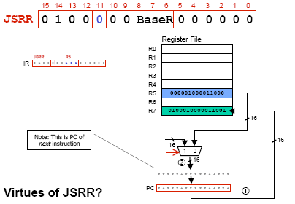
JSRR

Slide 65
F
D
EA
JSRR (Register)
OP
16
GatePC
16
GateMARMUX
EX
LD.PC
PC
DR
3
MARMUX
+1
REG FILE
16
2
PCMUX
16
16
16
16
16
LD.REG
S
[7:0]
SR2
SR2
OUT
SR1
OUT
SR1
SEXT
+
3
3
ADDR2MUX
MUX
MUX
ADDR1MUX
16
16
[10:0]
16
16
16
16
16
SEXT
[8:0]
LD.CC
16
SEXT
FINITE STATE MACHINE
SR2MUX
[5:0]
SEXT
16
N
Z
P
ALUK
A
B
[4:0]
SEXT
2
ALU
LD.IR
IR
LOGIC
…
16
16
16
RUN
GateALU
16
GateMDR
16
LD.MDR
MDR
MEMORY
MAR
LD.MAR
16
INPUT
OUTPUT
MIO.EN
MUX
16
MEM.EN,R,W

Slide 66
F
D
EA
JSRR (Register)
OP
16
GatePC
16
GateMARMUX
EX
LD.PC
PC
DR
3
MARMUX
+1
REG FILE
16
2
PCMUX
16
16
16
16
16
LD.REG
S
[7:0]
SR2
SR2
OUT
SR1
OUT
SR1
SEXT
+
3
3
ADDR2MUX
MUX
MUX
ADDR1MUX
16
16
[10:0]
16
16
16
16
16
SEXT
[8:0]
LD.CC
16
SEXT
FINITE STATE MACHINE
SR2MUX
[5:0]
SEXT
16
N
Z
P
ALUK
A
B
[4:0]
SEXT
2
ALU
LD.IR
IR
LOGIC
…
16
16
16
RUN
GateALU
16
GateMDR
16
LD.MDR
MDR
MEMORY
MAR
LD.MAR
16
INPUT
OUTPUT
MIO.EN
MUX
16
MEM.EN,R,W

Slide 67
F
D
EA
JSRR (Register)
OP
16
GatePC
16
GateMARMUX
EX
LD.PC
PC
DR
3
MARMUX
+1
REG FILE
16
2
PCMUX
16
16
16
16
16
LD.REG
S
[7:0]
SR2
SR2
OUT
SR1
OUT
SR1
SEXT
+
3
3
ADDR2MUX
MUX
MUX
ADDR1MUX
16
16
[10:0]
16
16
16
16
16
SEXT
[8:0]
LD.CC
16
SEXT
FINITE STATE MACHINE
SR2MUX
[5:0]
SEXT
16
N
Z
P
ALUK
A
B
[4:0]
SEXT
2
ALU
LD.IR
IR
LOGIC
…
16
16
16
RUN
GateALU
16
GateMDR
16
LD.MDR
MDR
MEMORY
MAR
LD.MAR
16
INPUT
OUTPUT
MIO.EN
MUX
16
MEM.EN,R,W

Slide 68
JSRR (Register)
F
D
EA
OP
EX
S
16
GatePC
16
GateMARMUX
LD.PC
PC
DR
3
MARMUX
+1
REG FILE
16
2
PCMUX
16
16
16
16
16
LD.REG
[7:0]
SR2
SR2
OUT
SR1
OUT
SR1
SEXT
+
3
3
ADDR2MUX
MUX
MUX
ADDR1MUX
16
16
[10:0]
16
16
16
16
16
SEXT
[8:0]
LD.CC
16
SEXT
FINITE STATE MACHINE
SR2MUX
[5:0]
SEXT
16
N
Z
P
ALUK
A
B
[4:0]
SEXT
2
ALU
LD.IR
IR
LOGIC
…
16
16
16
RUN
GateALU
16
GateMDR
16
LD.MDR
MDR
MEMORY
MAR
LD.MAR
16
INPUT
OUTPUT
MIO.EN
MUX
16
MEM.EN,R,W

Slide 69
JSRR (Register)
F
D
EA
OP
EX
S
16
GatePC
16
GateMARMUX
LD.PC
PC
DR
3
MARMUX
+1
REG FILE
16
2
PCMUX
16
16
16
16
16
LD.REG
[7:0]
SR2
SR2
OUT
SR1
OUT
SR1
SEXT
+
3
3
ADDR2MUX
MUX
MUX
ADDR1MUX
16
16
[10:0]
16
16
16
16
16
SEXT
[8:0]
LD.CC
16
SEXT
FINITE STATE MACHINE
SR2MUX
[5:0]
SEXT
16
N
Z
P
ALUK
A
B
[4:0]
SEXT
2
ALU
LD.IR
IR
LOGIC
…
16
16
16
RUN
GateALU
16
GateMDR
16
LD.MDR
MDR
MEMORY
MAR
LD.MAR
16
INPUT
OUTPUT
MIO.EN
MUX
16
MEM.EN,R,W

Slide 70
Subroutine Template
01 SUB_NAME
02 ;Register Saving
03 ST R0, SUB_R0
04 ST R1, SUB_R1
05 …
06 ST R6, SUB_R6
07 ST R7, SUB_R7;Return address
08
09 ;***Code***
10
11 ;Register Restoring
12 LD R0, SUB_R0
13 LD R1, SUB_R1
14 …
15 LD R6, SUB_R6
16 LD R7, SUB_R7 ;Return address
17 RET

Slide 71
Example: Negate the value in R0
TwosComp NOT R0,R0 ;flip bits
ADD R0,R0,#1 ;add one
RET ;return to caller
To call from a program
;need to compute R4 = R1-R3
ADD R0,R3,#0 ;copy R3 to R0
JSR TwosComp ;negate
ADD R4,R1,R0 ;add to R1
...

Slide 72
Using Subroutines
Programmer must know
  Address: or at least a label that will be bound to its address
  Function: what it does
    NOTE: The programmer does not need to know how the subroutine works, but what changes are visible in the machine’s state after the routine has run
  Arguments: what they are and where they are placed
  Return values: what they are and where they are placed

Slide 73
Passing Information To Subroutines
Argument(s)
  Value passed in to a subroutine is called an argument
  This is a value needed by the subroutine to do its job
  Examples
    TwosComp: R0 is number to be negated
    OUT: R0 is character to be printed
    PUTS: R0 is address of string to be printed
How?
  In registers (simple, fast, but limited number)
  In memory (many, but awkward, expensive)
  Both

Slide 74
Getting Values From Subroutines
Return Values
  A value passed out of a subroutine is called a return value
  This is the value that you called the subroutine to compute
  Examples
    TwosComp: negated value is returned in R0
    GETC: character read from the keyboard is returned in R0
How?
  Registers, memory, or both
  Single return value in register most common

Slide 75
Saving and Restore Registers
Like service routines, must save and restore registers
  Who saves what is part of the calling convention
Generally use “callee-save” strategy, except for return values
  Same as trap service routines
  Save anything that subroutine alters internally that shouldn’t be visible when the subroutine returns
  Restore incoming arguments to original values (unless overwritten by return value)
Remember
  You MUST save R7 if you call any other subroutine or trap
  Otherwise, you won’t be able to return!

Slide 76
Character Input Service Routine (IN, TRAP x23)
01 ; Service Routine for Keyboard Input
02 .ORIG x04A0 ;System call starting address
03 ST R7,SaveR7
04; ST R1,SaveR1 ;Save the values in the registers
05; ST R2,SaveR2 ;that are used so that they can
06; ST R3,SaveR3 ;be restored before RET
07 JSR SaveReg
08;
09;Output Newline on CRT
10 LD R2,Newline
11; L1 LDI R3,DSR ;Check CRTDR—is it free?
12; BRzp L1 ;Loop until monitor is ready
13; STI R2,DDR ;Move cursor to new clean line
14 JSR WriteChar
15;
16;Output “Input a character”
17 LEA R1,Prompt ;Prompt is starting address
18 ;of prompt string
19;Loop LDR R0,R1,#0 ;Get next prompt character
20 Loop LDR R2,R1,#0
21 BRzp Input ;Check for end of prompt string
22;L2 LDI R3, DSR
23; BRzp L2
24; STI R0,DDR ;Write next character of prompt
25 JSR WriteChar
26 ADD R1,R1,#1 ;Increment prompt point
27 BRnzp Loop

Slide 77
Character Input Service Routine (IN, TRAP x23)
28;Input a character from KB
29;Input LDI R3,KBSR ;Has a character been typed?
30; BRzp Input
31; LDI R0,KBDR ;Load it into R0
32 JSR ReadChar
33 ADD R2,R2,#0 ;Move char to R2 for writing
34 ;echo to monitor
35;Echo the character on CRT
36; L3 LDI R3,DSR
37; BRzp L3
38; STI R0,DDR ;Echo input character to CRT
39 JSR WriteChar
40;
41;Output Newline on CRT
42; L4 LDI R3,DSR ;Check CRTDR—is it free?
43; BRzp L4
44; STI R2,DDR ;Move cursor to new clean line 45 LD R2,Newline
46 JSR WriteChar
47;
48;Restore
49 LD R7,SaveR7
50; LD R1,SaveR1 ;Service routine done, restore
51; LD R2,SaveR2 ;original values in registers.
52; LD R3,SaveR3
53 JSR RestoreReg
54 RET ;Return to calling program

Slide 78
Character Input Service Routine (IN, TRAP x23)
53;Memory for registers saved
54;SaveR1 .FILL x0000
55;SaveR2 .FILL x0000
56;SaveR3 .FILL x0000
57;
58;DSR .FILL xF3FC
59;DDR .FILL xF3FF
60;KBSR .FILL xF400
61;KBDR .FILL xF401
62;
63 Newline .FILL x000A ;ASCII code for newline
64 Prompt .STRINGZ”Input a character>”
65
66;Subroutine:Output a charactor on CRT
67 WriteChar LDI R3,DSR
68 BRzp WriteChar
69 STI R2,DDR ;R2 save a char to be written
70 RET
71 DSR .FILL xFE04
72 DDR .FILL xFE06

Slide 79
Character Input Service Routine (IN, TRAP x23)
73;Subroutine:Input a charactor from KB
74 ReadChar LDI R3,KBSR
75 BRzp ReadChar
76 LDI R0,KBDR ;R0 save a char read from KB
77 RET
78 KBSR .FILL xFE00
79 KBDR .FILL xFE02
80;
81;Subroutine:Save the values in the register that are used
82;so that they can be restored before RET
83 SaveReg ST R1,SaveR1
84 ST R2,SaveR2
85 ST R3,SaveR3
86 ST R4,SaveR4
87 ST R5,SaveR5
88 ST R6,SaveR6
89 RET
90;

Slide 80
Character Input Service Routine (IN, TRAP x23)
91;Subroutine:Restore the original values that saved in the
92;register
93 RestoreReg LD R1,SaveR1
94 LD R2,SaveR2
95 LD R3,SaveR3
96 LD R4,SaveR4
97 LD R5,SaveR5
98 LD R6,SaveR6
99 RET
100;
101;Memory for registers saved
102 SaveR1 .BKLW 1 ; SaveR1 .FILL x0000
103 SaveR2 .BKLW 1
104 SaveR3 .BKLW 1
105 SaveR4 .BKLW 1
106 SaveR5 .BKLW 1
107 SaveR6 .BKLW 1
108 ;
109 .END

Slide 81
A program fragment to compute the hypotenuse of a right triangle, using a library routine
01;C = SQRT(SQUARE（a)+ SQUARE（b))
02 …
03 .EXTERNAL SQRT
04 …
05 …
06 LD R0,SIDE1 ;SQUARE（SIDE1)
07 BRz 1$
08 JSR SQUARE
09 1$ ADD R1,R0,#0
0A LD R0,SIDE2 ;SQUARE（SIDE2)
0B BRz 2$
0C JSR SQUARE
0D 2$ ADD R0,R0,R1 ;R0 contains argument x
0E LD R4, SQRTAddr
0F JSRR R4
10 ST R0,HYPOT
11 BRnzp NEXT_TASK
12 SQUARE ADD R2,R0,#0
13 ADD R3,R0,#0
14 AGAIN ADD R2,R2,#-1
15 BRz DONE
16 ADD R0,R0,R3
17 BRnzp AGAIN
18 DONE RET

Slide 82
A program fragment to compute the hypotenuse of a right triangle, using a library routine
19 SQRTAddr .FILL SORT
1A SIDE1 .BLKW 1
1B SIDE2 .BLKW 1
1C HYPOT .BLKW 1
1D …
1E …

Slide 83
Library Routines
Call subroutines in other object files (or library)
  Assembler/linker must support EXTERNAL symbols
  Extra “linking” step will fill in value of SQRTAddr
Using JSRR, because SQRT likely not “nearby”
. . .
. EXTERNAL SQRT
...
LD R4,SQRTAddr ;load SQRT addr
JSRR R4
...
SQRTAddr .FILL SQRT
.END

